Slide 1






EXPLORING ICT AS A CATALYST FOR TECHNOLOGICAL ADOPTION
Insights from Action Research

Slide 2



Situation Overview: The "Swachh Bharat" initiative has undeniably made remarkable strides in providing sanitation infrastructure to Indian families. However, the persisting challenge of open defecation in rural villages, despite infrastructure development, highlights the complex nature of the issue.
Need for Change: In confronting open defecation challenges, there exists a critical need for transformative approaches. Merely providing infrastructure is insufficient; a deeper understanding of the community dynamics and a holistic strategy are imperative for lasting change.
Introduction

Slide 3
Impact Importance: The impact of open defecation extends far beyond hygiene concerns. It directly affects community health, poses environmental hazards, and influences the overall well-being of the population. Addressing this issue is not just a matter of infrastructure but a fundamental requirement for community prosperity.
Methodological Approach: We employ a synergy of Participatory Rural Appraisal (PRA) for active community engagement and Human-Centered Design (HCD) for a user-centric design process. Action research transforms insights into tangible outcomes, fostering a comprehensive understanding of community needs.
Introduction

Slide 4



Assess effectiveness of awareness campaigns in Mamanathodi village.
VIdentify challenges hindering open defecation eradication.
Objective
Utilize participatory tools for comprehensive insights.
Explore ICT for systematic awareness program management.

Slide 5

Participatory Rural Appraisal (PRA):
Active engagement of local residents using tools like community mapping, transect walks, and seasonal calendars.
Aims to empower the community to share insights, ensuring a holistic understanding of challenges.
Human-Centered Design (HCD):
Emphasizes a user-centric approach to design, tailoring interventions to the specific needs and preferences of the community.
Focused on creating contextually relevant and effective strategies for open defecation-free communities.
Methods
and Methodology

Slide 6
Interdisciplinary Team Approach:
A team comprising both engineering and humanities backgrounds collaborated to bring diverse perspectives.
Stayed in the community for ten days, dedicating initial days to ice-breaking and
the rest to participatory research.
Duration of Stay:
Ten days spent immersing in the community for a comprehensive understanding of challenges.
Combined efforts of an interdisciplinary team ensured a well-rounded approach to data collection and analysis.
Methods
and Methodology

Slide 7
Methodology
Our study adopts a multi-faceted methodology, strategically combining diverse approaches for a nuanced understanding:
Participatory Rural Appraisal (PRA):
Engaged the community actively through tools like community mapping, transect walks, and seasonal calendars.
Unearthed valuable insights and perspectives from the local residents.
Human-Centered Design (HCD):
Embraced a user-centric design process to tailor interventions to the specific needs and preferences of the community.
Ensured that solutions resonate with the community's cultural context.
Action Research:
Translated gathered insights into practical outcomes, emphasizing a hands-on, participatory approach.
Facilitated a deeper understanding of the community's needs and challenges through real-world engagement.
This methodological amalgamation not only captures the richness of community dynamics but also empowers us to propose effective, context-sensitive solutions.

Slide 8
TOOLS
Resource Map
Spatial representation of key resources with community involvement.
Identified resource locations to understand their distribution.
Income Expenditure
Mapping income sources, expenditures, and financial patterns.
Revealed economic challenges faced by the community.

Slide 9
TOOLS
Seasonal Calendar
Problem Tree
Illustrated challenges in agriculture, water, sanitation, and more.
Identified waste management and open defecation as common challenges.
Mapped activities for twelve months related to water, sanitation, health, and agriculture.
Highlighted the impact of seasons on productivity and hygiene challenges.

Slide 10

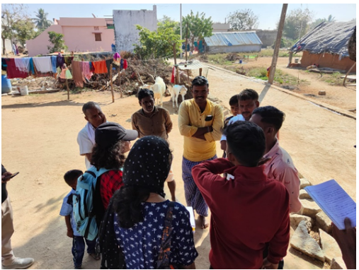
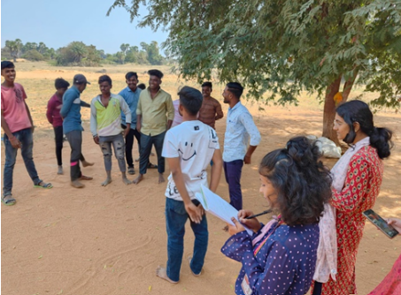
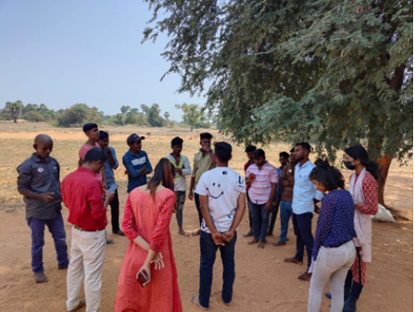
Brainstorming
Photo 1
Photo 2
Photo 3

Slide 11
Brainstorming
OBJECTIVE
PROCESS
KUMO DIAGRAM
SIGNIFICANCE
Collaborative brainstorming included older farmers, educated youth, and government officials
Analyze expenditure sheet findings, prioritizing challenges from previous tools.
Facilitated discussions, encouraging diverse perspectives and insights.
Collective prioritization of challenges to ensure comprehensive consideration.
Visual representation summarizing prioritized challenges.
Efficient tool for capturing consensus from diverse stakeholders.
Enhances collaboration, fostering a holistic understanding.
Facilitates consensus building and aids in effective decision-making.

Slide 12
Identified Challenges
OPEN DEFECATION
WASTE MANAGEMENT
HEALTH RISKS
TECHNOLOGICAL
BARRIERS
Despite efforts, open defecation remains a widespread and persistent challenge.
Cultural norms and behavioral factors contribute to the prevalence.
Waste management emerges consistently as a shared challenge.
Lack of effective systems and awareness contributes to improper waste disposal.
.
The Seasonal Calendar highlights health risks during specific seasons.
Poor sanitation practices during the rainy season contribute to heightened health issues.
Limited technological adoption in certain communities hinders the implementation of ICT-driven solutions.
Bridging the digital divide is crucial for successful technology-based interventions.

Slide 13

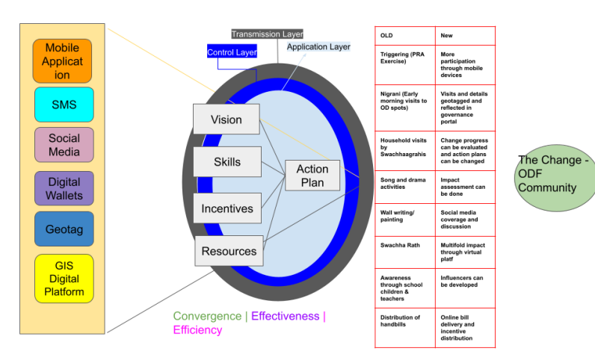
Envisioning Change: Leveraging ICT
for Sustainable Sanitation
ICT architecture visualizes a transformative approach, combining cloud-based solutions and real-time data analytics for efficient sanitation interventions.

Slide 14
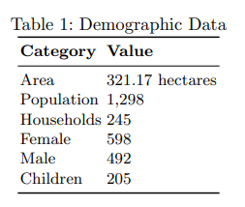
Result
The study in Raichur district revealed persistent challenges in open defecation and slow adoption of toilet technology. Despite improved infrastructure, economic struggles in Mamanathodi village impact sanitation practices. Seasonal dynamics exacerbate health risks, emphasizing the need for tailored programs considering cultural norms. Action research highlights successful community-led initiatives and effective use of ICT in awareness campaigns, indicating the importance of nuanced, culturally sensitive approaches for sustainable change.

Slide 15


Recommendations
Community Finance Support:
Establish community funds for financial aid.
1
Tailored Cultural Awareness:
Design culturally specific programs.
2
ICT Skill Building:
Focus on digital empowerment for the community.
3

Slide 16
Recommendations
Government-Community Task Force:
Form collaborative groups for joint decision-making.
1
Continuous Feedback:
Implement real-time feedback mechanisms.
2
Live-in-Labs Expansion:
Extend program reach to neighboring villages.
3

Slide 17
Future scope
Scaling Successful Interventions:
Explore scaling to neighboring regions.
Collaborate with local authorities.
1
Long-Term Monitoring and Evaluation:
Establish continuous monitoring.
Implement feedback mechanisms.
2
Expansion of Live-in-Labs Program:
Extend to broader geographical reach.
Foster experiential learning.
3

Slide 18
Future scope
Research on Evolving Challenges:
Conduct follow-up studies.
Stay abreast of technological advancements.
1
Digital Empowerment Initiatives:
Integrate digital literacy programs.
Explore mobile applications.
2
Collaborative Partnerships:
Form partnerships with governmental bodies.
Establish a collaborative task force.
3

Slide 19
References
1. Ajith, V., Reshma, A., Mohan, R., Ramesh, M.V.: Empowering communities in addressing drinking water challenges using a systematic, participatory and adaptive approach and sustainable ppp model. Technological Forecasting and Social Change 185, 121970 (2022)
2. Biswas, S., Dandapat, B., Alam, A., Satpati, L.: India’s achievement towards sustainable development goal 6 (ensure availability and sustainable management of water and sanitation for all) in the 2030 agenda. BMC Public Health 22(1), 1–16 (2022)
. Bora, P.: The problem of open defecation: India’s fight for odf
4. Donkor, F.K.: Adaptive water, sanitation, and hygiene management: Resilient governance systems. In: Clean Water and Sanitation, pp. 1–12. Springer (2022)
5. Friedrich, M., Balasundaram, T., Muralidharan, A., Raman, V., Mosler, H.J.: Increasing latrine use in rural karnataka, india using the risks, attitudes, norms, abilities, and self-regulation approach: A cluster-randomized controlled trial. Science of The Total Environment 707, 135366 (2020)
6. Gauri, V., Rahman, T., Sen, I.K.: Shifting social norms to reduce open defecation in rural india. Behavioural Public Policy 7(2), 266–290 (2023)
7. Jain, P., Patel, S.: Longitudinal assessment of sanitation interventions and open defecation behavior in rural india. Public Health Perspectives 10(3), 214–226 (2020)
8. Kasareddy, R., Mukhopadhyay, A.: Fpms: A fog based poultry monitoring system. In: 2022 IEEE 2nd Mysore Sub Section International Conference (MysuruCon). pp. 1–6 (2022). https://doi.org/10.1109/MysuruCon55714.2022.9972632

Slide 20
References
9. Kouassi, H.A.A., Andrianisa, H.A., Traor´e, M.B., Sossou, S.K., Nguematio, R.M., Djambou, M.D.:
Acceptance factors for the social norms promoted by the community-led total sanitation (clts) approach
in the rural areas: Case study of the central-western region of burkina faso. Sustainability 15(15), 11945
(2023)
10. Kumar, A., Sharma, R., Gupta, M.: Exploring open defecation in rural india: A qualitative study on
perceptions and practices. Journal of Health, Population, and Nutrition 36(1), 11 (2018)
11. Lippitt, M.: The managing complex change model. Enterprise Management. Retrieved from:
https://www. the-registry. org/Portals/0/Documents/Credentials/Administrator/Documents/managing%
20complex% 20change. pdf (1987)
12. Losey, L., Ogden, E., Bisrat, F., Solomon, R., Newberry, D., Coates, E., Ward, D., Hilmi, L., LeBan,
K., Burrowes, V., et al.: The core group polio project: an overview of its history and its contributions
to the global polio eradication initiative. The American journal of tropical medicine and hygiene 101(4
Suppl), 4 (2019)
13. Mukherjee, S., Dasgupta, P.: Economic implications of open defecation: Evidence from a cost-of-illness
study in india. Health Economics Review 9(1), 15 (2019)
14. Okurut, K., Charles, K.J.: Household demand for sanitation improvements in low-income informal
settlements: A case of east african cities. Habitat international 44, 332–338 (2014)
1

Slide 21
References
15. Organization, W.H., et al.: Progress on household drinking water, sanitation and hygiene 2000-2020: five years into the sdgs (2021) 16. Ramesh, M.V., Nibi, K., Kurup, A., Mohan, R., Aiswarya, A., Arsha, A., Sarang, P.: Water quality monitoring and waste management using iot. In: 2017 IEEE global humanitarian technology conference (GHTC). pp. 1–7. IEEE (2017)
17. Ramesh, M.V., Muir, A., Nandanan, K., Bhavani, R.R., Mohan, R.: Hci curricula for sustainable inno?vation: the humanitarian focus at amrita vishwa vidyapeetham. Interactions 29(1), 54–57 (2022)
18. Roy, A., Rahaman, M., Adhikary, M., Kapasia, N., Chouhan, P., Das, K.C.: Unveiling the spatial divide in open defecation practices across india: an application of spatial regression and fairlie decomposition model. BMJ open 13(7), e072507 (2023)
19. Roy, A., Rahaman, M., Bannerji, R., Adhikary, M., Kapasia, N., Chouhan, P., Das, K.C.: Spatial clustering and drivers of open defecation practice in india: Findings from the fifth round of national family health survey (2019-21). Global Transitions 5, 55–63 (2023)
20. Sandeep, T.: A study on the effects of ict enabled gadgets and screen addiction among mechanical engineering students. Int. J. Mech. Eng. Technol 9, 1223–1227 (2018)
21. Talat, U., Ravenscroft, L., Vlaev, I.: Development of a behaviour change intervention to promote latrine use and reduce open defecation in rural india (2023)
22. Varma, D.S., Nandanan, K., PC, V.R., Soundharajan, B., P´erez, M.L., Sidharth, K., Ramesh, M.V.: Participatory design approach to address water crisis in the village of karkatta, jharkhand, india. Tech?nological Forecasting and Social Change 172, 121002 (2021) 23. VerKuilen, A., Sprouse, L., Beardsley, R., Lebu, S., Salzberg, A., Manga, M.: Effectiveness of the swachh bharat mission and barriers to ending open defecation in india: a systematic review. Frontiers in Environmental Science 11, 565 (2023

Slide 22

THANK YOU

